Slide 1
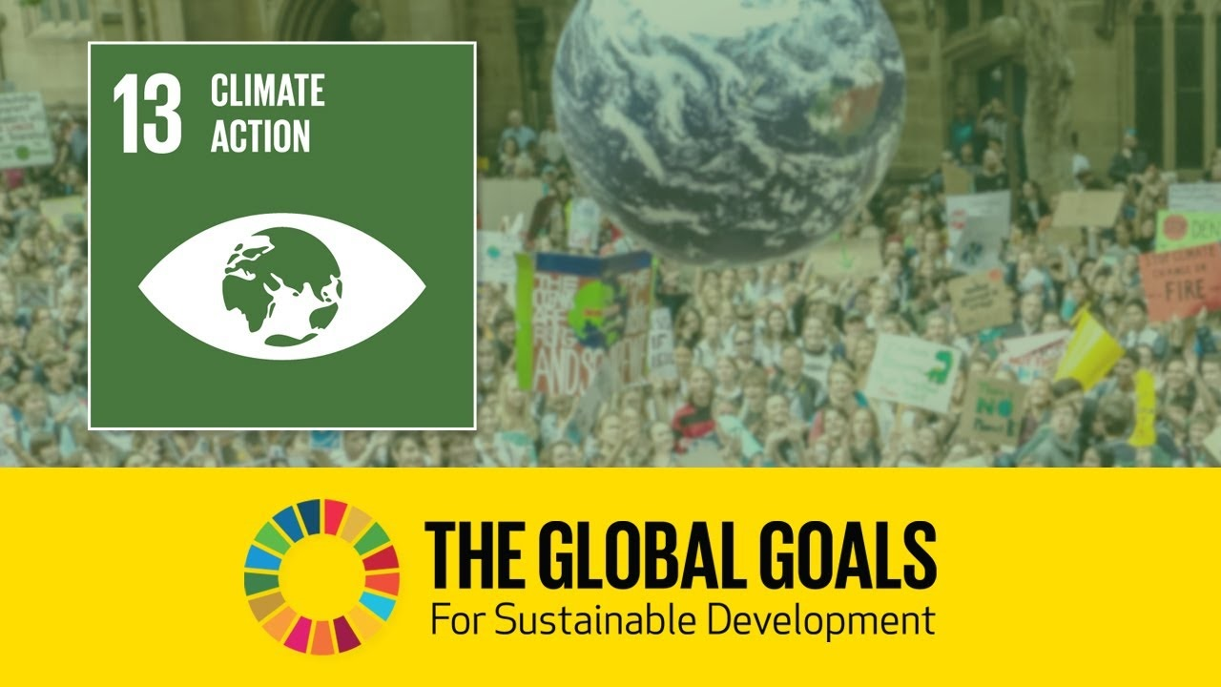

Slide 2

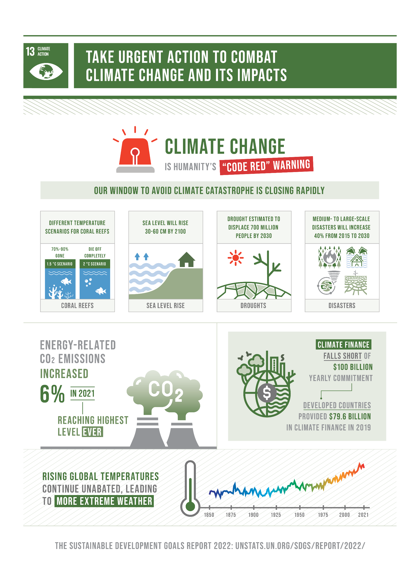
In June 1992, at the Earth Summit in Rio de Janeiro, Brazil, more than 178 countries adopted Agenda 21, a comprehensive plan of action to build a global partnership for sustainable development to improve human lives and protect the environment.
Goal 13: Take urgent action to combat climate change and its impacts:
13.2: Integrate climate change measures into national policies, strategies and planning.
13.a: Implement the commitment undertaken by developed-country parties to the United Nations Framework Convention on Climate Change to a goal of mobilizing jointly $100 billion annually by 2020 from all sources to address the needs of developing countries in the context of meaningful mitigation actions and transparency on implementation and fully operationalize the Green Climate Fund through its capitalization as soon as possible.

Slide 3
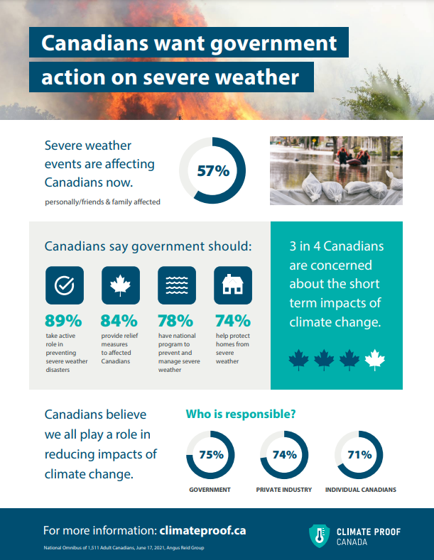

Questions that we found interesting and what motivated us to answer them:
This project aims to highlight the global climate action goal set by the UN in 1992 and analyze the development of these goals by Canada as a country between the years 1992 and 2022, in order to understand whether these goals are being achieved by the Government of Canada and for each province separately.

Slide 4
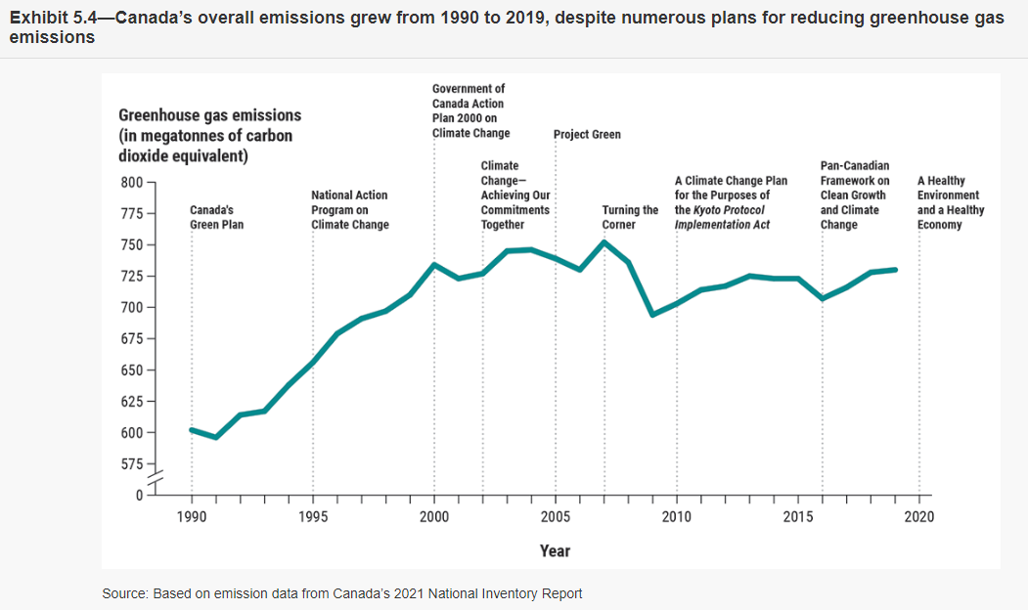

Slide 5
Where and how we found the data we used to answer these questions:
https://sdgs.un.org/goals
https://revelstoke.ca/324/Climate-Action
https://www.oag-bvg.gc.ca/internet/English/att__e_43947.html

Slide 6
Our conclusions:

Slide 7
The implications of our findings:

Slide 8
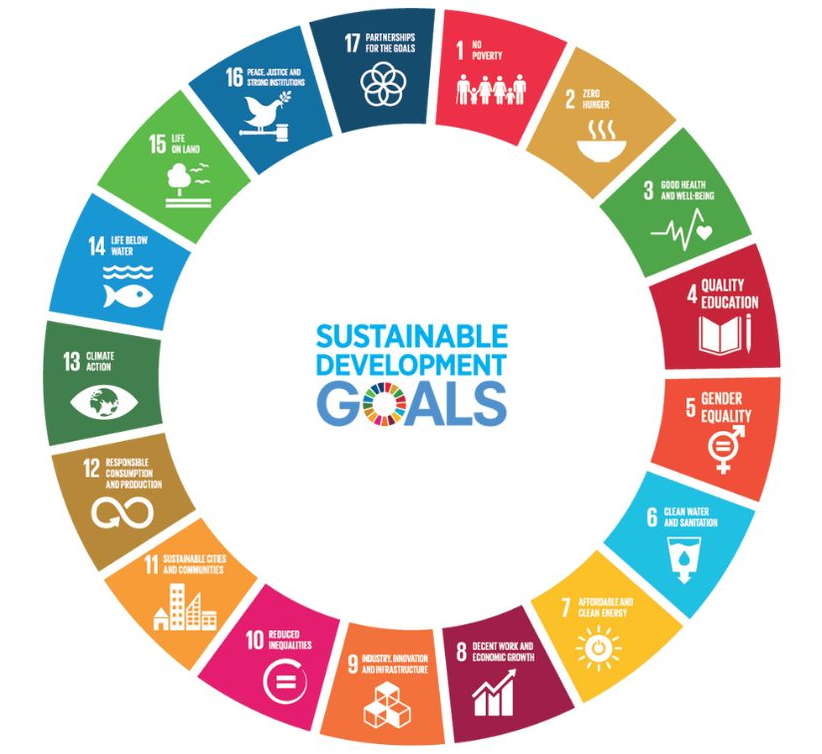
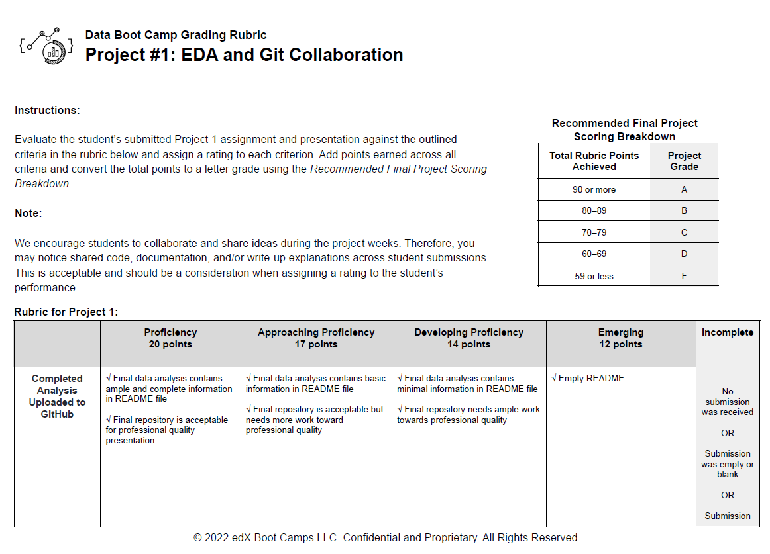

Slide 9
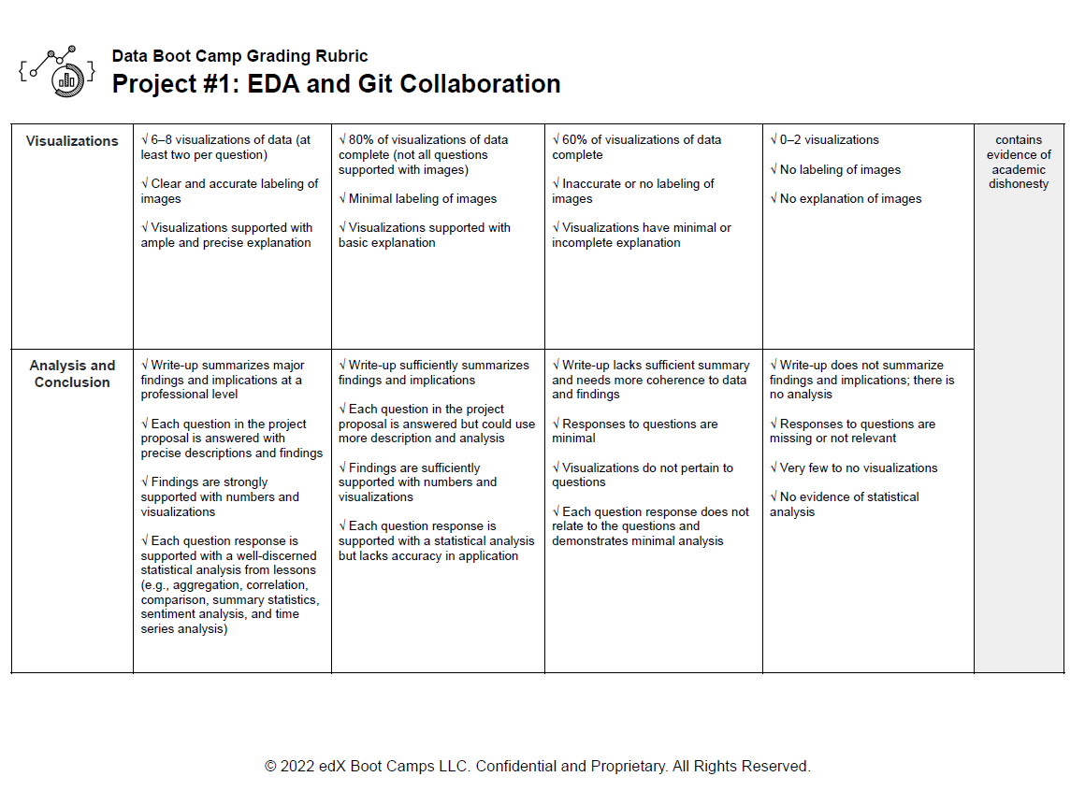

Slide 10
